Slide 1
Preparation of aspirin
Lecturer Raghad Aldoghachi

Slide 2
Aspirin
Aspirin is the common name for the compound acetylsalicylic acid, widely used as a fever reducer and as a pain killer.
Salicylic acid, whose name comes from Salix, the willow family of plants, was derived from willow bark extracts.
In folk medicine, willow bark teas were used as headache treatments. Nowadays, salicylic acid is administered in the form of aspirin which is less irritating to the stomach than salicylic acid.

Slide 3
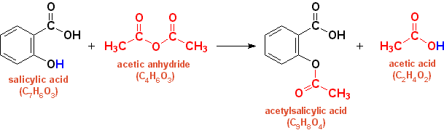
Preparation
To prepare aspirin, salicylic acid is reacted with an excess of acetic anhydride. A small amount of a strong acid such as sulfuric acid used as a catalyst which speeds up the reaction. The excess acetic acid will be reduced with the addition of water. The aspirin product is not very soluble in water so the aspirin product will precipitate when water is added. The synthes is reaction of aspirin is shown below:

Slide 4
A “purified product” can be obtained through recrystallization of the crude product in hot ethanol. In this experiment, the crude product will be the desired product.
The melting point range of pure aspirin is 138-140 °C and the melting point range of the salicylic acid starting material is 158-161 °C
If impurities are present in your crude sample, the melting point range for your product will be lower than the range of pure aspirin. Also, your melting point range may be greater than 2 degrees.

Slide 5
Leaving group
Acetic acid
Aspirin

Slide 6
Safety
Salicylic acid is able to penetrate and break down fats, causing moderate
chemical burns to the skin.
Acetic anhydride flammable, harmful by inhalation and if swallowed, causes
burns
Sulfuric acid causes severe burns.
So you must wear protective gloves, protective clothing, and eye protection.

Slide 7
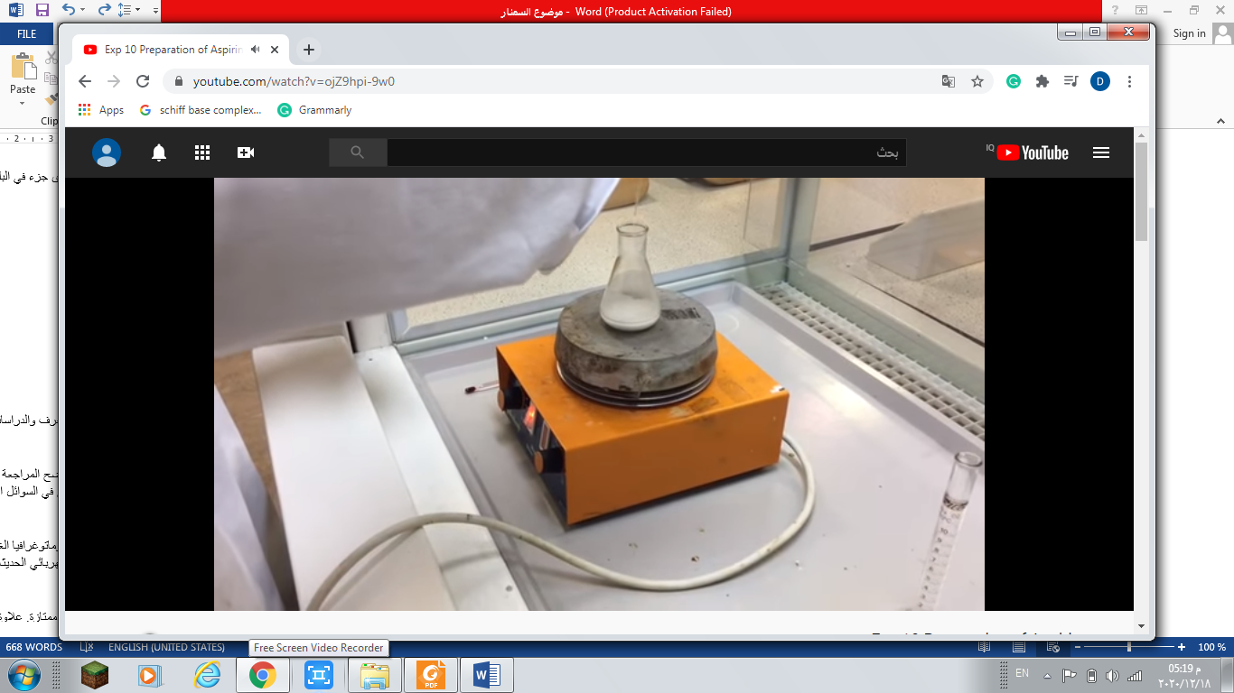
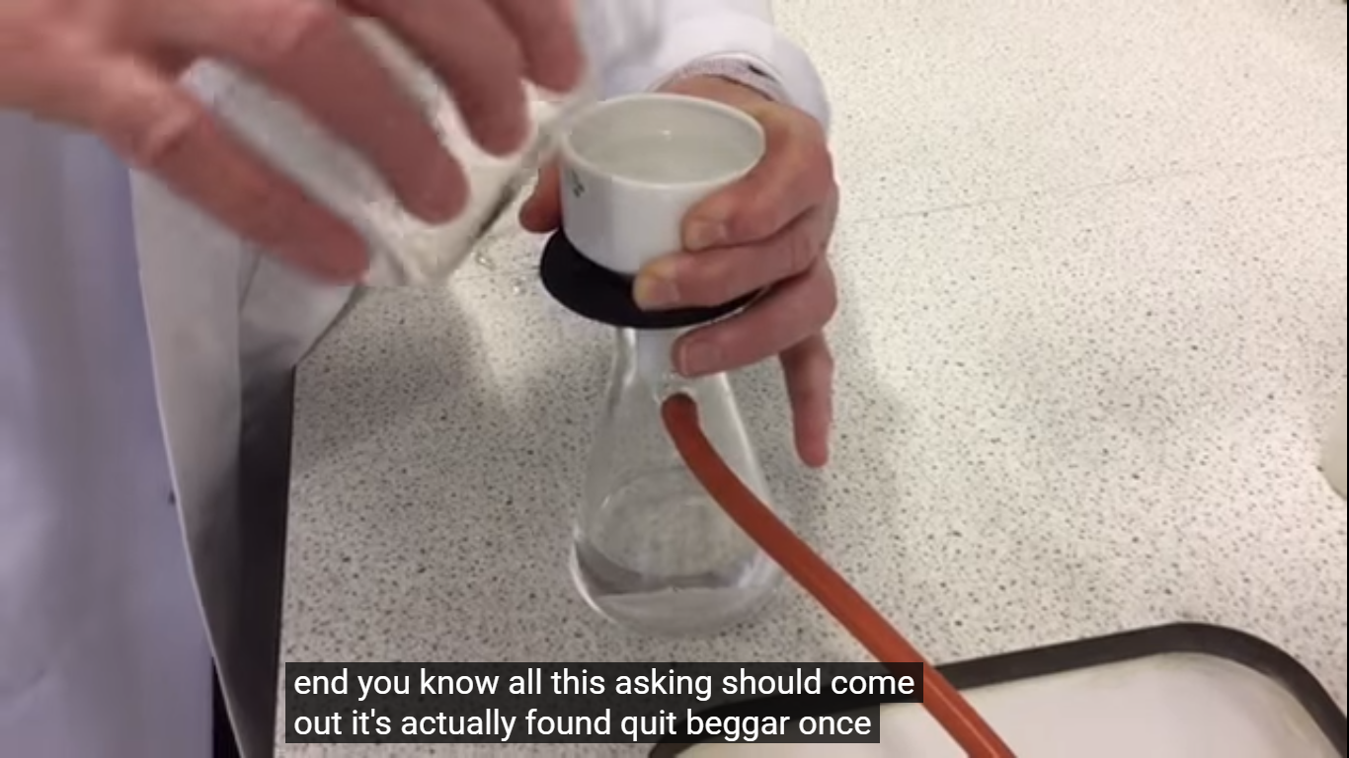

Slide 8
Procedure
1. Place 0.5 grams of salicylic acid into a beaker along with 3 mL of acetic anhydride and 5 drops of conc Hcl.
2. Heat the mixture for 10 minutes with stirring.
3. Cool the mixture by adding ice cubes with stirring. Crystals of aspirin started to form as the mixture cooled.
4. Filter the mixture and wash the crystals with cold distilled water.
5. Purification of Aspirin by recrystallization.
6. Calculate % yield.

Slide 9
Calculation
Moles (Salicylic acid) = Moles (Aspirin)
Wt / M.Wt (Salicylic acid) = Wt / M.Wt (Aspirin)
O.5 g /138.12 g mol-1 = Theoretical Wt / 180.16 g mol-1
% yield = Practical Wt / Theoretical Wt

Slide 10
Purification
Recrystallization of aspirin
The crude product was dissolved in 5ml of ethanol in a 100ml conical flask. The solution will be warmed if necessary. The solution was added with 30ml of hot distilled water.
The mixture is warmed until the solid dissolves completely in the solution.
Collect the product by filtration and wash it with water.

Slide 11
Melting Point
Weigh the dry product to obtain the yield of the reaction. Calculate the theoretical yield and percent yield of the reaction.
Pack a few crystals of your aspirin product in a melting point capillary tube.
3. The melting point of aspirin is determined.
The melting point range is the temperature when you first notice
the aspirin crystals melting up until the temperature when no crystals remain.

Slide 12
Report
Name of experiment, Date of experiment, purpose of experiment.
1. Report the theoretical yield and the percent yield of the aspirin product.
2. Compare the melting point of you aspirin product to the theoretical melting point (138-140 °C).
3.Is the crude product above of below this mark? Explain why this is the case.
4. Pharmaceutical uses of aspirin
5. side effect of aspirin

